Slide 1
Quantum Computing Basics
Jagan Narayan Natarajan
IBM Quantum
Date: December 20, 2024

Slide 2
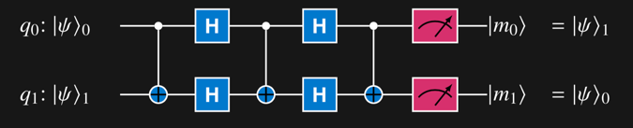
Quantum computing
A quantum circuit is a set of quantum gate operations on qubits and is the unit of computation
A quantum bit or qubit is a controllable quantum object that is the unit of information

Slide 3

Bits and Qubits
0
Probability = |a|²
Probability = |b|²
1
A quantum circuit is a set of quantum gate operations on qubits and is the unit of computation
A quantum bit or qubit is a controllable quantum object that is the unit of information

Slide 4
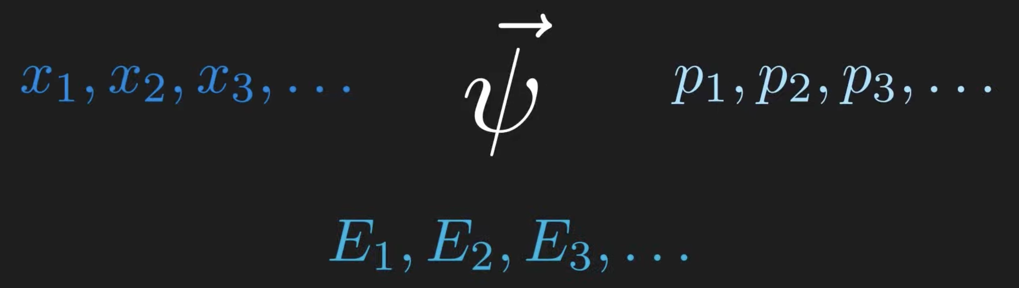
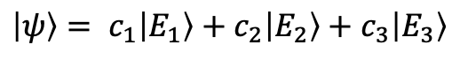
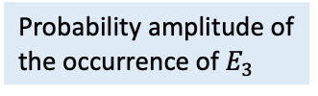
Quantum State
“A quantum state is represented mathematically as a unit vector in a complex Hilbert space, which encodes the probabilities of measurement outcomes.”
- Michael A. Nielsen and Isaac L. Chuang
Physicists expressed this mathematically as
Basis state vector, one of the energy state which is measured
$$\left|ψ\right\rangle = c_{1}\left|E_{1}\right\rangle +c_{2}\left|E_{2}\right\rangle +c_{3}\left|E_{3}\right\rangle$$
Quantum State vector using bra-ket notation
Probability amplitude of the occurrence of $E_{3}$

Slide 5
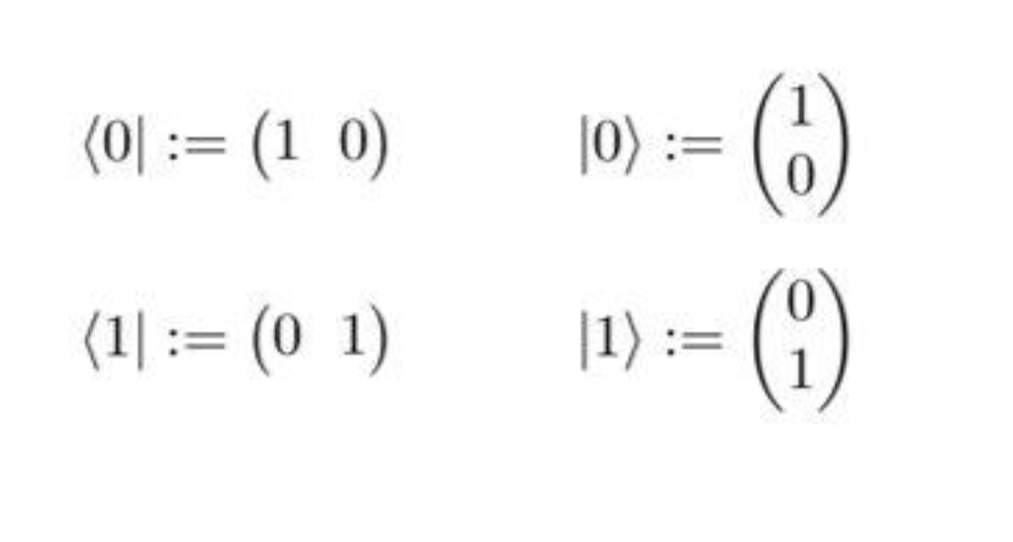
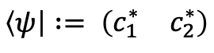
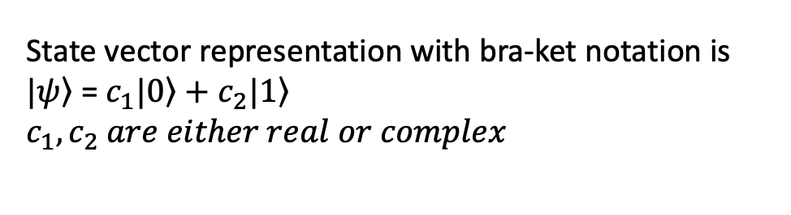
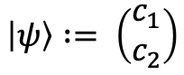
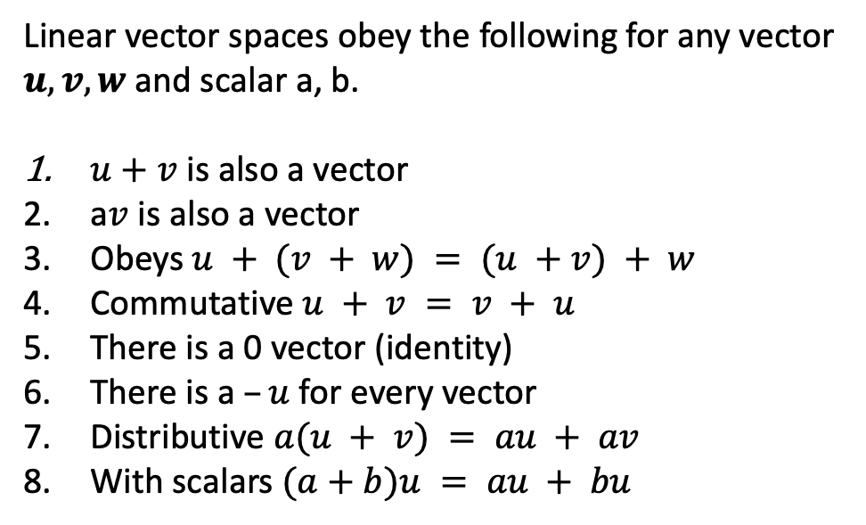
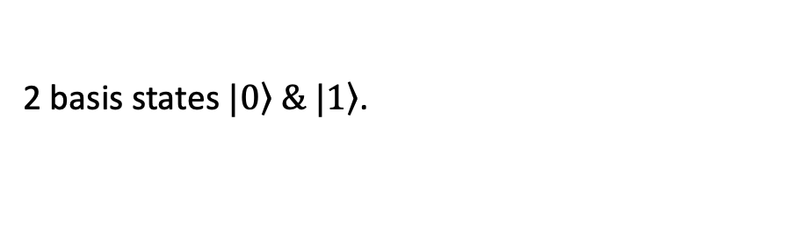
Quantum State
Linear vector spaces obey the following for any vector $u,v,w$and scalar a, b.
$u+v$ is also a vector
a$v$ is also a vector
Obeys $u + (v + w) = (u +v) + w$
Commutative $u + v = v + u$
There is a 0 vector (identity)
There is a $–u$ for every vector
Distributive $a(u + v) = au + av$
With scalars $(a+b)u = au + bu$
State vector representation with bra-ket notation is $\left.|ψ\right\rangle$ = $c_{1}\left.|0\right\rangle +c_{2}\left.|1\right\rangle$
$$c_{1},c_{2} are either real or complex$$
2 basis states $\left.|0\right\rangle \&\left. |1\right\rangle$.
$$\left|ψ\right\rangle := \left(\begin{matrix}c_{1} \\ c_{2}\end{matrix}\right)$$
$$\left\langle ψ\right| := \left(\begin{matrix}c_{1}^{∗} & c_{2}^{∗}\end{matrix}\right)$$
If an additional component, inner product is defined on a vector space – Hilbert Space

Slide 6
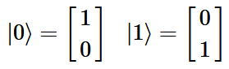
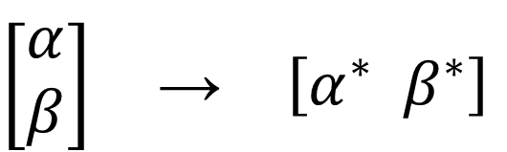
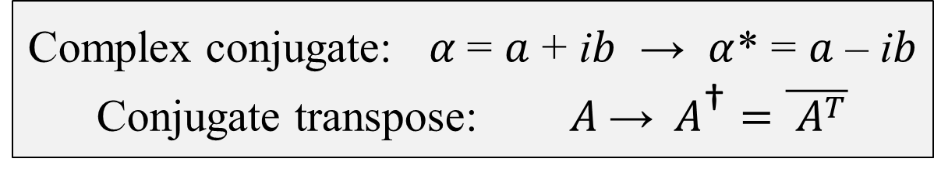
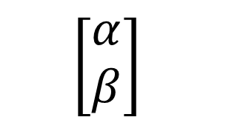
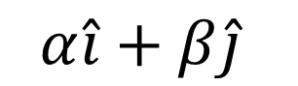


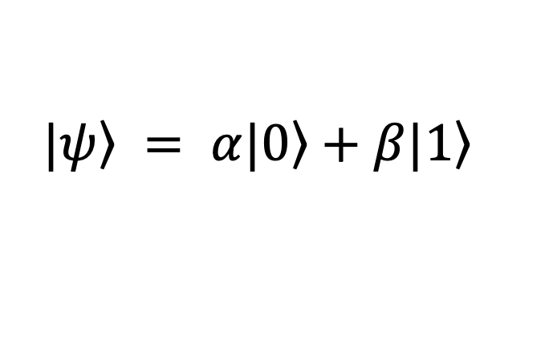
Notation
Dirac (Bra-Ket) Notation
Vectors
Matrix (Linear Algebra)
$\left.|0\right\rangle$ $\left.|1\right\rangle$
$$\hat{i} \hat{j}$$
ket
Complex Numbers
$$\left.|ψ\right\rangle = α\left.|0\right\rangle +β\left.|1\right\rangle$$
$$α\hat{i}+β\hat{j}$$
$$\left[\begin{aligned}α \\ β\end{aligned}\right]$$
Element in a complex Hilbert (vector) space
bra
⟨0|
⟨1|
conjugate transpose of a ket
Extends to n-dimensions
$$\left[\begin{aligned}α \\ β\end{aligned}\right] \text{→} \left[α^{∗}{ β}^{∗}\right]$$
Complex conjugate: $α$= $a$ + i$b$ → $α$* = $a$ – i$b$
Conjugate transpose: $A \text{→} A^{\text{†}}=\overline{ A^{T}}$
ket
(column vector)
bra
(row vector)
Notes:
Dirac notation, vector equivalent, ket, bra.
Mention why we are using the term basis states for |0> and |1>; because they are orthonormal bases in a complex 2D vector space.

Slide 7
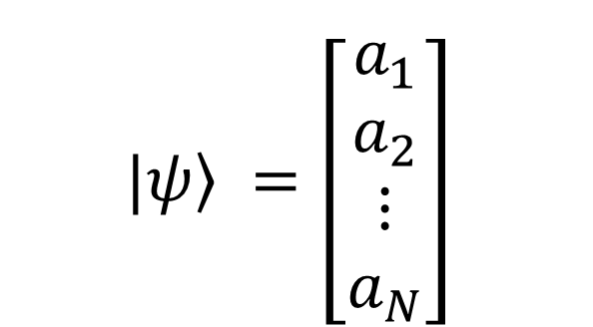
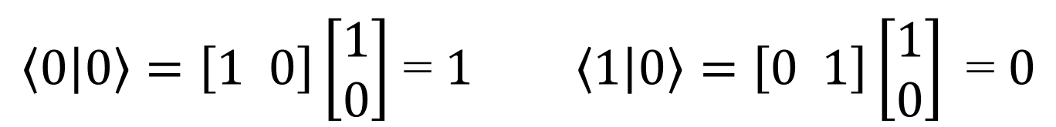
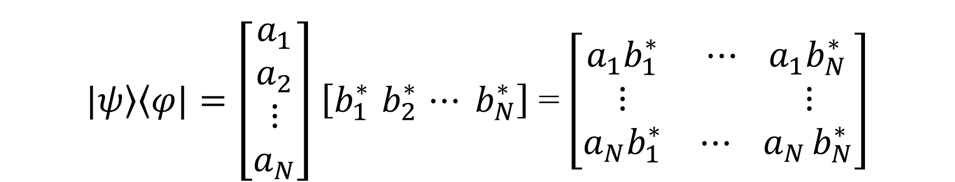
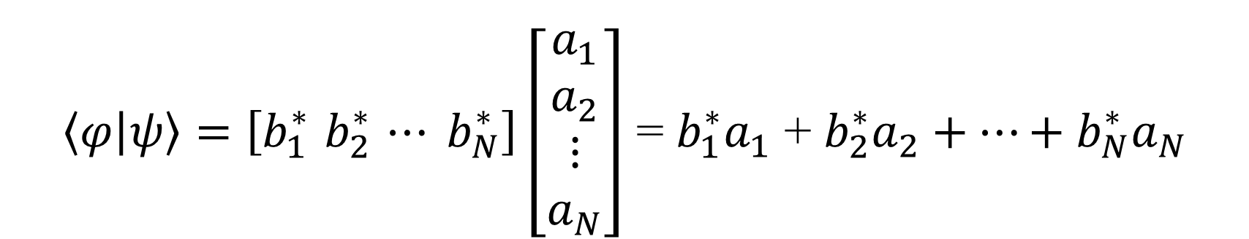
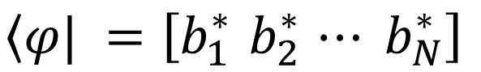
Notation (continued)
$$\left.|ψ\right\rangle =\left[\begin{aligned}a_{1} \\ a_{2} \\ ⋮ \\ a_{N}\end{aligned}\right]$$
bra
$$\left\langle φ|\right. =\left[b_{1}^{∗}{ b}_{2}^{∗} ⋯ b_{N}^{∗}\right]$$
ket
$\left\langle φ | ψ\right\rangle =\left[b_{1}^{∗}{ b}_{2}^{∗} ⋯ b_{N}^{∗}\right]\left[\begin{aligned}a_{1} \\ a_{2} \\ ⋮ \\ a_{N}\end{aligned}\right]$ = $b_{1}^{∗}a_{1}$ + $b_{2}^{∗}a_{2}+⋯+b_{N}^{∗}a_{N}$
$\left\langle 0 | 0\right\rangle =\left[1 0\right]\left[\begin{aligned}1 \\ 0\end{aligned}\right]$ = $1 \left\langle 1 | 0\right\rangle =\left[0 1\right]\left[\begin{aligned}1 \\ 0\end{aligned}\right]\text{ = }0$
bra-ket
Inner product (single complex number)
like vector dot product
$\left.|ψ\right\rangle \left\langle φ|\right.=\left[\begin{aligned}a_{1} \\ a_{2} \\ ⋮ \\ a_{N}\end{aligned}\right]$ $\left[b_{1}^{∗}{ b}_{2}^{∗} ⋯ b_{N}^{∗}\right]$ = $\left[\begin{matrix}a_{1}b_{1}^{∗} & ⋯ a_{1}b_{N}^{∗} \\ \begin{aligned}⋮ \\ a_{N}b_{1}^{∗}\end{aligned} & \begin{aligned} ⋮ \\ {⋯ a}_{N}b_{N}^{∗}\end{aligned}\end{matrix}\right]$
ket-bra
Outer product (N-by-N matrix) linear transformation operator
Notes:
Inner product (bra-ket), outer product (ket-bra)
Discuss inner product of orthogonal vectors (is zero) while identical vectors is 1.

Slide 8
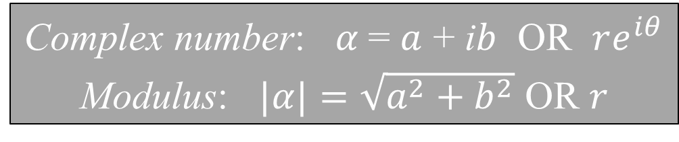
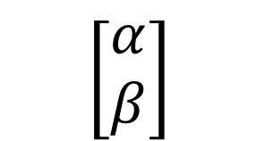
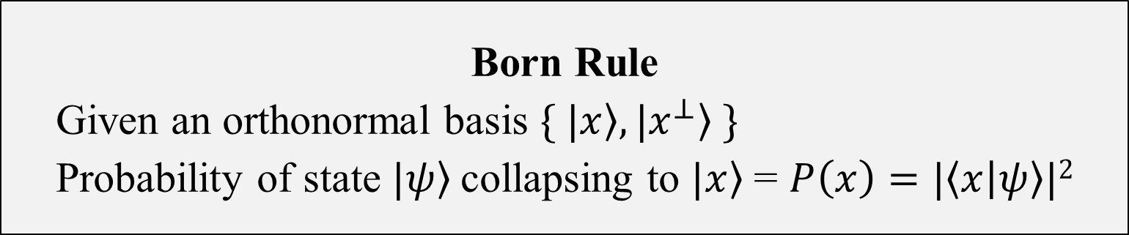
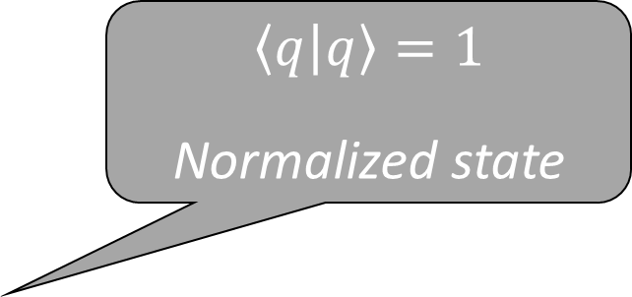
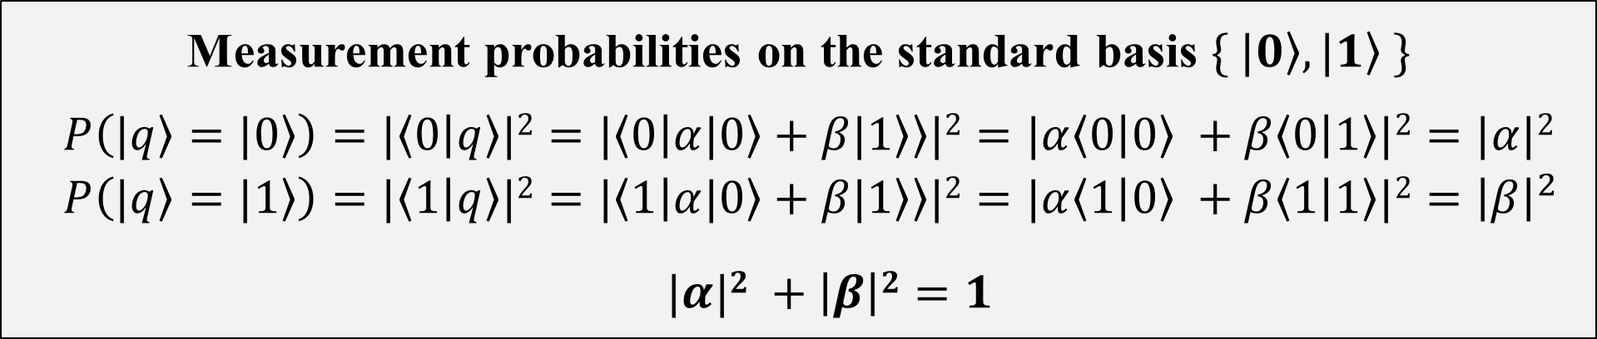
Single Qubits
A vector in complex two-dimensional Hilbert space
General qubit state (state vector)
$\left.|q\right\rangle = α\left.|0\right\rangle +β\left.|1\right\rangle α,β ∈ ℂ$
$$\left[\begin{aligned}α \\ β\end{aligned}\right]$$
Complex number: $α$= $a$ + i$b$ OR $re^{iθ}$
Modulus: $|α|=\sqrt{a^{2}+b^{2}}$ OR $r$
Orthonormal basis states (Inner product = 0)
Measurement collapses qubit to basis state
Measurement probabilities on the standard basis $\{ \left.|0\right\rangle , \left.|1\right\rangle \}$
$$P\left(\left.|q\right\rangle =\left.|0\right\rangle \right)=|\left\langle 0 | q\right\rangle |2=|\left\langle 0 | α\left.|0\right\rangle +β\left.|1\right\rangle \right\rangle |2=|α\left\langle 0 | 0\right\rangle +β\left\langle 0 | 1\right\rangle |2=|α|2$$
$$P\left(\left.|q\right\rangle =\left.|1\right\rangle \right)=|\left\langle 1 | q\right\rangle |2=|\left\langle 1 | α\left.|0\right\rangle +β\left.|1\right\rangle \right\rangle |2=|α\left\langle 1 | 0\right\rangle +β\left\langle 1 | 1\right\rangle |2={\left|β\right|}^{2}$$
$|α|2$ $+ \left|β\right|2=1$
Born Rule
Given an orthonormal basis $\{ \left.|x\right\rangle , \left.{|x}^{⊥}\right\rangle \}$
Probability of state $\left.|ψ\right\rangle$collapsing to $\left.|x\right\rangle$ = $P\left(x\right)=|\left\langle x | ψ\right\rangle |2$
$$\left\langle q | q\right\rangle =1$$
Normalized state
Notes:
Mathematical representation
Orthogonal basis states: |0>, |1>. Inner product is zero. Vector representations, matrix representation
Talk about measurement and normalization
Born rule

Slide 9
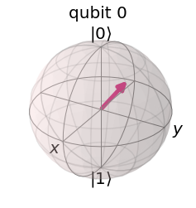
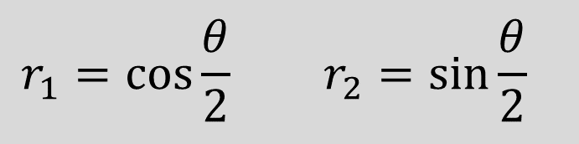
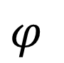

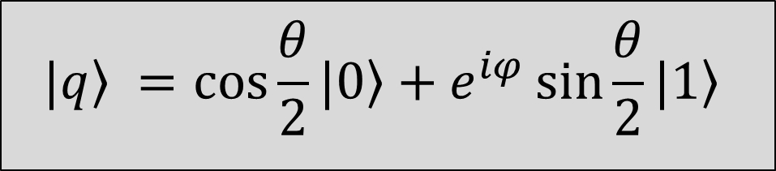
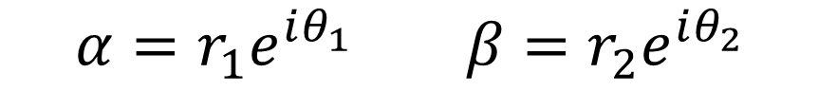
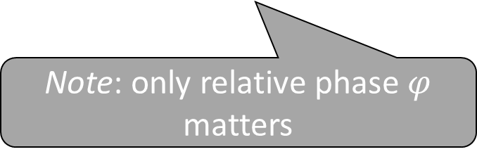
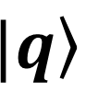
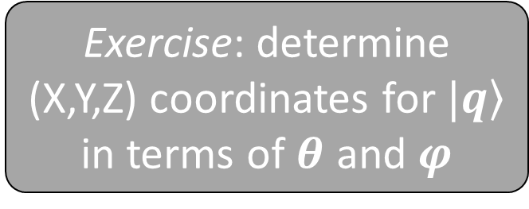

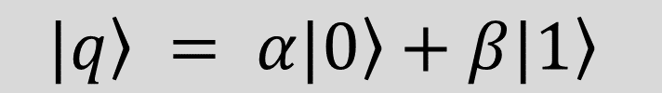
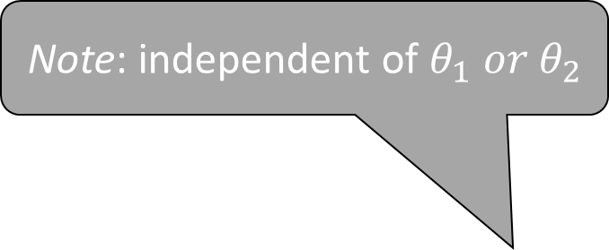
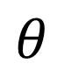
Qubit Representation
Note: angle twice as large as in Hilbert space
$$\left.|q\right\rangle = α\left.|0\right\rangle +β\left.|1\right\rangle$$
Note: independent of $θ_{1} or{ θ}_{2}$
$$α=r_{1}e^{iθ_{1}} β=r_{2}e^{iθ_{2}}$$
$$θ$$
$$\left.|q\right\rangle$$
$$r_{1}2 + r_{2}2 =1$$
$$r_{1}=\cos{\frac{θ}{2} }r_{2}=\sin{\frac{θ}{2}}{ }$$
$$φ$$
$$θ_{1}=θ_{2}+φ$$
Exercise: determine (X,Y,Z) coordinates for $\left.|q\right\rangle$ in terms of $θ$ and $φ$
$$\left.|q\right\rangle =\cos{\frac{θ}{2}}\left.|0\right\rangle +e^{iφ}\sin{\frac{θ}{2}}\left.|1\right\rangle$$
Note: only relative phase $φ$ matters
Notes:
Visual representation (Bloch sphere)
Bloch vector, angles twice as large in Bloch sphere as in Hilbert space

Slide 10
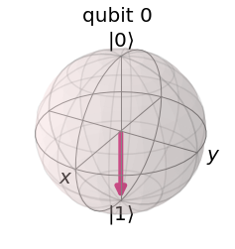
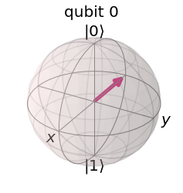
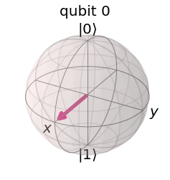
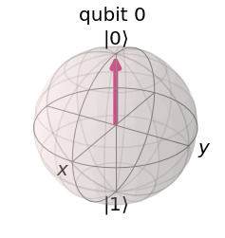
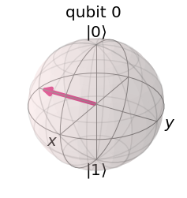
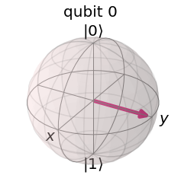
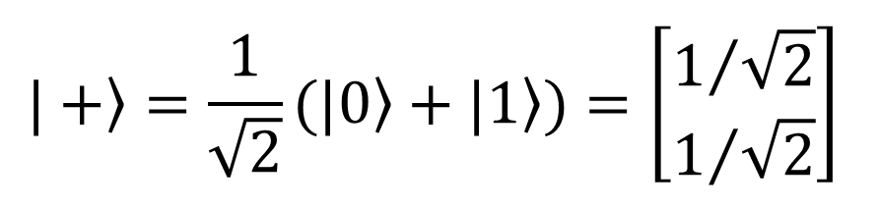
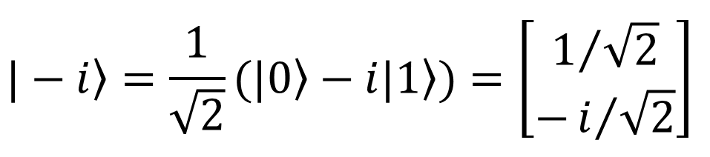
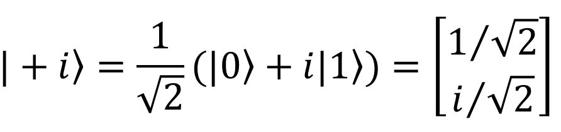
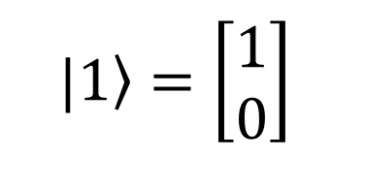
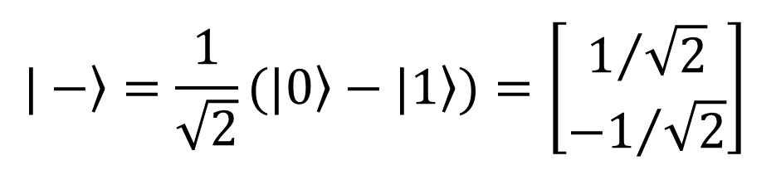
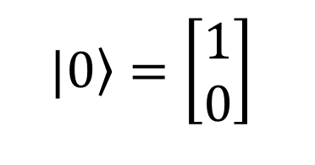
Notable Examples of Single Qubits
$$\left.|0\right\rangle =\left[\begin{aligned}1 \\ 0\end{aligned}\right]$$
$$\left.|1\right\rangle =\left[\begin{aligned}1 \\ 0\end{aligned}\right]$$
$$\left.|+\right\rangle =\frac{1}{\sqrt{2}}\left.(|0\right\rangle +\left.|1\right\rangle )=\left[\begin{aligned}1/{\sqrt{2}} \\ 1/{\sqrt{2}}\end{aligned}\right]$$
$$\left.|−\right\rangle =\frac{1}{\sqrt{2}}\left.(|0\right\rangle −\left.|1\right\rangle )=\left[\begin{aligned}1/{\sqrt{2}} \\ {−1}/{\sqrt{2}}\end{aligned}\right]$$
$$\left.|+i\right\rangle =\frac{1}{\sqrt{2}}\left.(|0\right\rangle +\left.i|1\right\rangle )=\left[\begin{aligned}1/{\sqrt{2}} \\ i/{\sqrt{2}}\end{aligned}\right]$$
$$\left.|−i\right\rangle =\frac{1}{\sqrt{2}}\left.(|0\right\rangle −\left.i|1\right\rangle )=\left[\begin{aligned}1/{\sqrt{2}} \\ −i/{\sqrt{2}}\end{aligned}\right]$$
Notes:
0,1 +- i,-I
Talk about: Z-measurement is what we do. X-measurement is equivalent mathematically but not possible physically.

Slide 11
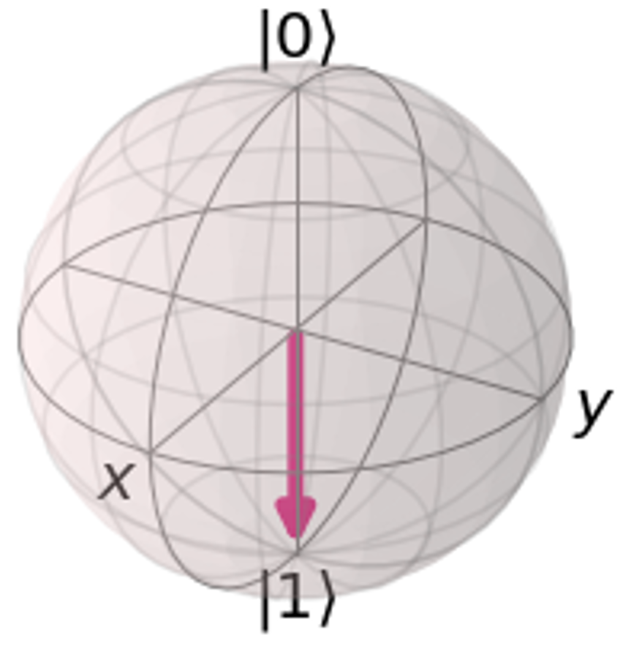










Bloch Sphere representation
$\text{θ}$ = 0
$φ$ = (0, 2π)
$|\left.Ψ\right\rangle$ = $cos 0 |\left.0\right\rangle$ + $e^{iφ}$ $sin 0 |\left.1\right\rangle$
= $|\left.0\right\rangle$
$\text{θ}$ = π
$φ$ = (0, 2π)
$|\left.Ψ\right\rangle$ = $cos\frac{\text{π}}{2} |\left.0\right\rangle$ + $e^{iφ}$ $sin\frac{\text{π}}{2} |\left.1\right\rangle$
= $|\left.1\right\rangle$
$\text{θ}$ = $\frac{\text{π}}{2}$
$φ$ = 0
$|\left.Ψ\right\rangle$ = $cos\frac{\text{π}}{4}|\left.0\right\rangle$ + $e^{i0}$ $sin\frac{\text{π}}{4}|\left.1\right\rangle$
= $|\left.+\right\rangle$
$\text{θ}$ = $\frac{\text{π}}{2}$
$φ$ = $\text{π}$
$|\left.Ψ\right\rangle$ = $cos\frac{\text{π}}{4}|\left.0\right\rangle$ + $e^{i\text{π}}$ $sin\frac{\text{π}}{4}|\left.1\right\rangle$
= $|\left.−\right\rangle$
$\text{θ}$ = $\frac{\text{π}}{2}$
$φ$ = $\frac{\text{π}}{2}$
$|\left.Ψ\right\rangle$ = $cos\frac{\text{π}}{4}|\left.0\right\rangle$ + $e^{i\frac{\text{π}}{2}}$ $sin\frac{\text{π}}{4}|\left.1\right\rangle$
= $|\left.+i\right\rangle$
$\text{θ}$ = $\frac{\text{π}}{2}$
$φ$ = $\frac{\text{3}\text{π}}{2}$
$|\left.Ψ\right\rangle$ = $cos\frac{\text{π}}{4}|\left.0\right\rangle$ + $e^{i\frac{\text{3}\text{π}}{2}}$ $sin\frac{\text{π}}{4}|\left.1\right\rangle$
= $|\left.−i\right\rangle$

Slide 12


Inner Product
Also known as the overlap operator
More overlap of the state to the basis state more probable to find it there
Yields a scalar number
$$Innerproduct\left(ψ,φ\right)=scalar$$
$$\left\langle φ | ψ\right\rangle =scalar$$
$$\left\langle φ | \left(ζ+ψ\right)\right\rangle =\left\langle φ | ζ\right\rangle +\left\langle φ | ψ\right\rangle$$
$$\left\langle φ | aψ\right\rangle =a \left\langle φ | ψ\right\rangle$$
$$\left\langle aφ | ψ\right\rangle =a∗⟨φ|ψ⟩$$
$$\left\langle φ | ψ\right\rangle = {⟨ψ|φ⟩}^{∗}$$
Orthogonal if
$\left\langle φ | ψ\right\rangle =0$ - note they do not have overlap
$\left.|ψ\right\rangle$ = $c_{1}\left.|0\right\rangle +c_{2}\left.|1\right\rangle$. $\left\langle 1 | 1\right\rangle \& \left\langle 0 | 0\right\rangle =1$
$\left\langle 1 | 0\right\rangle =0$ & $\left\langle 1 | 0\right\rangle =0$ as they are 2 independent states with no overlap
We see
$$\left\langle ψ | ψ\right\rangle =⟨ψ|{(c}_{1}\left.|0\right\rangle +c_{2}\left.|1⟩)\right\rangle =c_{1}\left\langle ψ | 0\right\rangle +c_{2}\left\langle ψ | 1\right\rangle$$
$=c_{1}\left\langle c_{1}^{∗}\left\langle 0\right|+c_{2}^{∗}\left\langle 1\right|) | 0\right\rangle +$ $c_{2}\left\langle c_{1}^{∗}\left\langle 0\right|+c_{2}^{∗}\left\langle 1\right|) | 1\right\rangle$
$$=c_{1}c_{1}^{∗}\left\langle 0 | 0\right\rangle + c_{1}c_{2}^{∗}\left\langle 1 | 0\right\rangle +c_{2}c_{1}^{∗}\left\langle 0 | 1\right\rangle +c_{2}c_{2}^{∗}\left\langle 1 | 1\right\rangle$$
$={|c_{1}|}^{2}\left\langle 0 | 0\right\rangle$ + ${|c_{2}|}^{2}\left\langle 1 | 1\right\rangle$
$$={|c_{1}|}^{2}+{|c_{2}|}^{2}$$

Slide 13



Outer Product
Now what is $\left|0\right\rangle \left\langle 0\right|$
Let us find $\left|ψ\right\rangle \left|0\right\rangle \left\langle 0\right|=\left|0\right\rangle \left\langle 0\right| ψ⟩$
$$=\left|0\right\rangle \left\langle 0\right|\left(c_{1}\left.|0\right\rangle +c_{2}\left.|1\right\rangle \right)$$
$=$ $c_{1}\left|0\right\rangle \left\langle 0\right|0⟩ +$ $c_{2}\left.|0\right\rangle \left\langle 0 | 1\right\rangle$
$$=c_{1}\left|0\right\rangle$$
As $\left\langle 0\right|0⟩$ = 1 and $\left\langle 0 | 1\right\rangle$ = 0
Also known the projection operator
Yields a matrix
Used to denote density matrix
Start with $\left.|ψ\right\rangle$ = $c_{1}\left.|0\right\rangle +c_{2}\left.|1\right\rangle$
Let us find $|ψ⟩⟨ψ|$
$$=(c_{1}\left.|0\right\rangle +c_{2}\left.|1\right\rangle ){(c}_{1}^{∗}⟨0|+c_{2}^{∗}⟨1|)$$
$=$ $c_{1}c_{1}^{∗ }\left|0\right\rangle \left\langle 0\right|+$ $c_{1}c_{2}^{∗}\left.|0\right\rangle \left\langle 1\right|+c_{2}c_{1}^{∗}\left.|1\right\rangle ⟨0|+c_{2}c_{2}^{∗}\left.|1\right\rangle ⟨1|$

Slide 14



Unitary Transformations
Let $U= \left(\begin{matrix}1 & 2+i \\ 2−i & 3\end{matrix}\right)$
$$U^{T}=\left(\begin{matrix}1 & 2−i \\ 2+i & 3\end{matrix}\right)$$
$$U^{†}=\left(\begin{matrix}1 & 2+i \\ 2−i & 3\end{matrix}\right)$$
Unitary transformation is a transformation that preserves the inner product
Unitary matrix is denoted by U
Unitary operations are rotation gates
$$UU^{†}=U^{†}U=I$$
$U^{†}$is called Hermitian Conjugate
$\left\langle ψ | φ\right\rangle$ is the inner product $U$ operation of both $\left|ψ\right\rangle$ and $\left|φ\right\rangle$ should not change $\left\langle ψ | φ\right\rangle$
$$\left\langle ψ | φ\right\rangle =\left\langle Uψ | Uφ\right\rangle$$
$=\left\langle Uψ\left|U\right|φ\right\rangle$
$$=\left\langle ψU^{†}\left|U\right|φ\right\rangle$$
=$\left\langle ψ\left|U^{†}U\right|φ\right\rangle =⟨ψ|φ⟩$

Slide 15







Single Qubit Gates
Elementary computation: changes qubit state
Unitary matrix
$$AA^{\text{†}}=I$$
A
Dirac notation
(Outer Product)
$$\left.|q\right\rangle$$
$$\left.|q′\right\rangle$$
In mathematical terms: a linear transformation of a vector (ket), or a matrix multiplication
$$A=\left[\begin{matrix}A_{00} & A_{01} \\ A_{10} & A_{11}\end{matrix}\right] A_{ij}∈ℂ$$
$A=A_{00}\left.|0\right\rangle \left\langle 0|\right. +A_{01}\left.|0\right\rangle \left\langle 1|\right.$ + $A_{10}\left.|1\right\rangle \left\langle 0|\right.$ + $A_{11}\left.|1\right\rangle \left\langle 1|\right.$
$$\left[\begin{aligned}α′ \\ β′\end{aligned}\right]=\left[\begin{matrix}A_{00} & A_{01} \\ A_{10} & A_{11}\end{matrix}\right]\left[\begin{aligned}α \\ β\end{aligned}\right]$$
$$\left.|q′\right\rangle = A\left.|q\right\rangle$$

Slide 16













Examples of Single Qubit Gates
Pauli-X,Y,Z Gates
$$σ_{X} = \left[\begin{matrix}0 & 1 \\ 1 & 0\end{matrix}\right] = \left.|0\right\rangle \left\langle 1|\right.+\left.|1\right\rangle \left\langle 0|\right.$$
Bit flip
Rotation around X-axis by $π$
Pauli-X gate
$σ_{X}\left.|0\right\rangle = \left[\begin{matrix}0 & 1 \\ 1 & 0\end{matrix}\right]\left[\begin{aligned}1 \\ 0\end{aligned}\right]=\left[\begin{aligned}0 \\ 1\end{aligned}\right]=\left.|1\right\rangle$
Phase flip
Rotation around Z-axis by $π$
$$σ_{Z} = \left[\begin{matrix}1 & 0 \\ 0 & −1\end{matrix}\right] = \left.|0\right\rangle \left\langle 0|\right.−\left.|1\right\rangle \left\langle 1|\right.$$
Pauli-Z gate
$$σ_{X}\left.|1\right\rangle =\left(\left.|0\right\rangle \left\langle 1|+\left.|1\right\rangle \left\langle 0|\right.\right.\right)\left.|1\right\rangle =$$
$\left.|0\right\rangle \left\langle 1 | 1\right\rangle +\left.|1\right\rangle \left\langle 0 | 1\right\rangle =\left.|0\right\rangle$
$$σ_{Y} = \left[\begin{matrix}0 & −i \\ i & 0\end{matrix}\right] = i\left(\left.|1\right\rangle \left\langle 0|\right.−\left.|0\right\rangle \left\langle 1|\right.\right)$$
$$σ_{Z}\left.|+\right\rangle =\left.|−\right\rangle σ_{Z}\left.|−\right\rangle =\left.|+\right\rangle$$
Pauli-Y gate
$$= iσ_{X}σ_{Z}$$
Bit & Phase flip
Rotation around Y-axis by $π$
$$∀i ∈\left\{X,Y,Z\right\} σ_{i}^{2}=I$$
$$σ_{X}(α\left.|0\right\rangle + β\left.|1\right\rangle )=β\left.|0\right\rangle +α\left.|1\right\rangle$$
Some combination of Pauli gates can be used to create any $2×2$matrix (or any single qubit rotation on the Bloch sphere)
Notes:
Transformations on Bloch sphere representing gate operations, Also show the matrix multiplication equivalents.
Pauli-X,Y,Z gates. Hadamard gate, S-gate.
Mention: NOT (X) gate can also act on superposition states.

Slide 17










Examples of Single Qubit Gates
Hadamard Gate
$$H =\frac{1}{\sqrt{2}}\left[\begin{matrix}1 & 1 \\ 1 & −1\end{matrix}\right] =\frac{1}{\sqrt{2}}(\left.|0\right\rangle \left\langle 0|+\left.|0\right\rangle \left\langle 1|\right.\right.+\left.|1\right\rangle \left\langle 0|\right.−\left.|1\right\rangle \left\langle 1|\right.)$$
Change between X and Z bases
$H\left.|0\right\rangle =\frac{1}{\sqrt{2}}\left[\begin{matrix}1 & 1 \\ 1 & −1\end{matrix}\right]\left[\begin{aligned}1 \\ 0\end{aligned}\right]=\frac{1}{\sqrt{2}}\left[\begin{aligned}1 \\ 1\end{aligned}\right]=\frac{1}{\sqrt{2}}(\left.|0\right\rangle + \left.|1\right\rangle )$
S Gate
$$S =\left[\begin{matrix}1 & 0 \\ 0 & i\end{matrix}\right]$$
$H(\frac{1}{\sqrt{2}}(\left.|0\right\rangle + \left.|1\right\rangle ))=\frac{1}{\sqrt{2}}\left[\begin{matrix}1 & 1 \\ 1 & −1\end{matrix}\right]\frac{1}{\sqrt{2}}\left[\begin{aligned}1 \\ 1\end{aligned}\right]=\left[\begin{aligned}1 \\ 0\end{aligned}\right]=\left.|0\right\rangle$
$$S\left.|+\right\rangle =\left.|+i\right\rangle$$
$$S\left.|−\right\rangle =\left.|−i\right\rangle$$
Add $\frac{π}{2}$to the phase
Notes:
To measure on X-basis: apply H and do a Z-measurement
To measure on Y-basis, apply SH and Z-measurement

Slide 18








Quantum Circuit
Sequence of building blocks (gates)
Gates carry out elementary computations
Circuits carry out complex computations
$${Hσ}_{X} =\frac{1}{\sqrt{2}}\left[\begin{matrix}1 & 1 \\ 1 & −1\end{matrix}\right]\left[\begin{matrix}0 & 1 \\ 1 & 0\end{matrix}\right]$$
Matrix multiplication
$${Hσ}_{X}\left.|0\right\rangle =\left.|−\right\rangle$$
$${Hσ}_{X}\left.|1\right\rangle =\left.|+\right\rangle$$
$$SH=\left[\begin{matrix}1 & 0 \\ 0 & i\end{matrix}\right]\frac{1}{\sqrt{2}}\left[\begin{matrix}1 & 1 \\ 1 & −1\end{matrix}\right]$$
Change between Y and Z bases
$$SH\left.|0\right\rangle =\left.|+i\right\rangle$$
$$S\left.H|1\right\rangle =\left.|−i\right\rangle$$
Notes:
Sequence of building blocks (gates) that carry out elementary computations
Show symbols for circuit lines and measurement lines, and different operators
Matrix multiplication order: reverse of gate sequence

Slide 19

Quantum Circuit
Measurement following input and computation
$$q^{′}= {Hσ}_{X}q=α′\left.|0\right\rangle + β′\left.|1\right\rangle$$
Computation
Input
Measurement (Output)
$$c= \left.|0\right\rangle with probability {\left|α′\right|}^{2}$$
$$c= \left.|1\right\rangle with probability {\left|β′\right|}^{2}$$
Notes:
Sequence of building blocks (gates) that carry out elementary computations
Show symbols for circuit lines and measurement lines, and different operators
Matrix multiplication order: reverse of gate sequence

Slide 20





Tensor Product
$$|\left.ψ\right\rangle \left.|φ\right\rangle =\left|ψ\right\rangle ⊗\left|φ\right\rangle =|ψφ⟩$$
Kronecker product of 2 states (example)
$\left[\begin{matrix}a \\ b\end{matrix}\right]⊗\left[\begin{matrix}c \\ d\end{matrix}\right]$ = $\left[\begin{matrix}a\left[\begin{matrix}c \\ d\end{matrix}\right] \\ b\left[\begin{matrix}c \\ d\end{matrix}\right]\end{matrix}\right]$ = $\left[\begin{aligned}\begin{matrix}ac \\ ad \\ bc\end{matrix} \\ bd\end{aligned}\right]$
Kronecker product of 2 operators (example)
$σz⊗σz$ = $\left[\begin{matrix}1 & 0 \\ 0 & −1\end{matrix}\right]⊗$ $\left[\begin{matrix}1 & 0 \\ 0 & −1\end{matrix}\right]$ = $\left[\begin{matrix}1 & 0 \\ \begin{aligned}0 \\ 0 \\ 0\end{aligned} & \begin{aligned}−1 \\ 0 \\ 0\end{aligned}\end{matrix} \begin{matrix}0 & 0 \\ \begin{aligned}0 \\ −1 \\ 0\end{aligned} & \begin{aligned}0 \\ 0 \\ 1\end{aligned}\end{matrix}\right]$
Let $\left.|ψ\right\rangle$ = $c_{1}\left.|0\right\rangle +c_{2}\left.|1\right\rangle$
$\left. |φ\right\rangle$ = $b_{1}\left.|0\right\rangle +b_{2}\left.|1\right\rangle$
$$\left|ψ\right\rangle ⊗\left|φ\right\rangle =\left(c_{1}\left.|0\right\rangle +c_{2}\left.|1\right\rangle \right)⊗\left(b_{1}\left.|0\right\rangle +b_{2}\left.|1\right\rangle \right)$$
$=$ $c_{1}\left.|0\right\rangle ⊗b_{1}\left.|0\right\rangle$ + $c_{1}\left.|0\right\rangle ⊗b_{2}\left.|1\right\rangle$ + $c_{2}\left.|1\right\rangle ⊗b_{1}\left.|0\right\rangle +c_{2}\left.|1\right\rangle ⊗b_{2}\left.|1\right\rangle$
$=$ $c_{1}$ $b_{1}\left|00\right\rangle + c_{1}b_{2}\left|01\right\rangle +{c_{2}b}_{1}\left|10\right\rangle +c_{2}b_{2}|11⟩$
Is $\left|ψ\right\rangle ⊗\left|φ\right\rangle =\left|φ\right\rangle ⊗\left|ψ\right\rangle$ ?

Slide 21


















Multiple Qubits
Scale up state space by combining single qubits
With $n$ qubits, we can represent $2^{n}$ states (vectors)
Tensor product
$2^{n}$-dim vector (multipartite state)
$$= \left[\begin{aligned}q_{11}q_{21} \\ q_{11}q_{22} \\ q_{12}q_{21} \\ q_{12}q_{22}\end{aligned}\right]$$
$$= \left[\begin{aligned}q_{11} \\ q_{12}\end{aligned}\right]⊗\left[\begin{aligned}q_{21} \\ q_{22}\end{aligned}\right]$$
$$= \left[\begin{aligned}q_{11}q_{21}⋯q_{n1} \\ ⋮ \\ q_{12}q_{22}⋯q_{n2}\end{aligned}\right]$$
4-dim vector
(bipartite state)
2-qubit state
$$\left.|q_{1}\right\rangle ⊗\left.|q_{2}\right\rangle$$
$$= \left[\begin{aligned}q_{11} \\ q_{12}\end{aligned}\right]⊗\left[\begin{aligned}q_{21} \\ q_{22}\end{aligned}\right]⊗⋯⊗\left[\begin{aligned}q_{n1} \\ q_{n2}\end{aligned}\right]$$
$n$-qubit state
$$\left.|q_{1}\right\rangle ⊗\left.|q_{2}\right\rangle ⊗⋯⊗\left.|q_{n}\right\rangle$$
$$= \left[\begin{aligned}0 \\ 1 \\ 0 \\ 0\end{aligned}\right]$$
$$= \left[\begin{aligned}1 \\ 0 \\ ⋮ \\ 0\end{aligned}\right]$$
$$= \left[\begin{aligned}1 \\ 0\end{aligned}\right]⊗\left[\begin{aligned}0 \\ 1\end{aligned}\right]$$
Probabilities: $\left\{{\left|q_{11}q_{21}\right|}^{2}, {\left|q_{11}q_{22}\right|}^{2},{\left|q_{12}q_{21}\right|}^{2},{\left|q_{12}q_{22}\right|}^{2}\right\}$
$\left.|01\right\rangle$ =
$$\left.|0\right\rangle ⊗\left.|1\right\rangle$$
$$= \left[\begin{aligned}1 \\ 0\end{aligned}\right]⊗\left[\begin{aligned}1 \\ 0\end{aligned}\right]⊗⋯⊗\left[\begin{aligned}1 \\ 0\end{aligned}\right]$$
${\left.|0\right\rangle }^{⊗n}$ =
$\left.|00⋯0\right\rangle$ =
$$\left.|0\right\rangle ⊗\left.|0\right\rangle ⊗⋯⊗\left.|0\right\rangle$$
Dirac notation
Dirac notation
$$q_{11}q_{21}\left.|00\right\rangle +q_{11}q_{22}\left.|01\right\rangle +q_{12}q_{21}\left.|10\right\rangle +q_{12}q_{22}\left.|11\right\rangle$$
$$q_{11}⋯q_{n1}{\left.|0\right\rangle }^{⊗n}+ ⋯ +q_{1n}{⋯q}_{nn}{\left.|1\right\rangle }^{⊗n}$$
4 states possible with $2$ qubits: $\left\{\left.|00\right\rangle ,\left.|01\right\rangle ,\left.|10\right\rangle ,\left.|11\right\rangle \right\}$
Notes:
Quantum state on multiple qubits
Representation from 2 to n, tensor product, visual representation in Q-sphere
Dirac notation, vector (matrix) notation
Mention why the output has 2^n states.

Slide 22




Multiple Qubit Gates
Transforms multipartite quantum state
A
$$\left.|q_{1}⋯q_{n}\right\rangle$$
$$\left.|q_{1}′⋯q_{n}′\right\rangle$$
A
$$\left.|q_{1}\right\rangle$$
$$⋮$$
$$\left.|q_{n}\right\rangle$$
$$\left.|q_{1}′\right\rangle$$
$$⋮$$
$$\left.|q_{n}′\right\rangle$$
Extra outputs for recovery of inputs: reversibility
Notes:
Representation as circuits, examples
Refer to tensor product of matrices (gates), with parallel Hadamard as example

Slide 23














The CNOT Gate
Equivalent of the XOR gate in classical computing
Controlled NOT
$$CNOT = \left[\begin{aligned}1 0 0 0 \\ 0 1 0 0 \\ 0 0 0 1 \\ 0 0 1 0\end{aligned}\right]$$
$$\left.|q_{1}q_{2}\right\rangle$$ | Output
$$\left.|00\right\rangle$$ | $$\left.|00\right\rangle$$
$$\left.|01\right\rangle$$ | $$\left.|01\right\rangle$$
$$\left.|10\right\rangle$$ | $$\left.|11\right\rangle$$
$$\left.|11\right\rangle$$ | $$\left.|10\right\rangle$$
Control qubit
$$\left.|q_{1}\right\rangle$$
$$\left.|q_{1}\right\rangle$$
$$=\left.|00\right\rangle \left\langle 00|\right.+\left.|01\right\rangle \left\langle 01|\right.+\left.|10\right\rangle \left\langle 11|\right.+\left.|11\right\rangle \left\langle 10|\right.$$
$$\left.|q_{2}\right\rangle$$
$$\left.|q_{1}⊕q_{2}\right\rangle$$
$$= \left[\begin{aligned}1 0 0 0 \\ 0 1 0 0 \\ 0 0 0 1 \\ 0 0 1 0\end{aligned}\right]\left[\begin{aligned}1 \\ 0 \\ 0 \\ 0\end{aligned}\right]$$
$$=\left[\begin{aligned}1 \\ 0 \\ 0 \\ 0\end{aligned}\right]$$
$$CNOT\left.|00\right\rangle$$
$$=\left.|00\right\rangle$$
Computes a NOT if control qubit is $\left.|1\right\rangle$

Slide 24






Tensor Product – correlated states
$$\left.|01\right\rangle$$
= $\left.|0\right\rangle ⊗\left.|1\right\rangle$
Correlated State: state that cannot be expressed as a tensor product of two states
$$\frac{1}{2}\left(\left.|00\right\rangle +\left.|01\right\rangle +\left.|10\right\rangle +\left.|11\right\rangle \right)$$
$$= \frac{1}{\sqrt{2}}(\left.|0\right\rangle +\left.|1\right\rangle )⊗\frac{1}{\sqrt{2}}(\left.|0\right\rangle +\left.|1\right\rangle )$$
$$\left|Φ^{+}\right\rangle = \frac{1}{\sqrt{2}}(\left.|00\right\rangle +\left.|11\right\rangle )$$
Entangled States: subset of correlated states
$$\left|Φ^{−}\right\rangle = \frac{1}{\sqrt{2}}\left(\left.|00\right\rangle −\left.|11\right\rangle \right)$$
$$\left|Ψ^{+}\right\rangle =\frac{1}{\sqrt{2}}\left(\left.|01\right\rangle +\left.|10\right\rangle \right)$$
$$\left|Ψ^{−}\right\rangle =\frac{1}{\sqrt{2}}\left(\left.|01\right\rangle −\left.|10\right\rangle \right)$$
Notes:
Uncorrelated, correlated, entangled states
Allude to pure vs mixed states (can’t be expressed as a ket with a coherent superposition of 0 and 1 because of decoherence; lies within the Bloch sphere)

Slide 25





Entanglement: Bell States
Entangled state is a pure state $\left.|ψ\right\rangle$ that cannot be expressed as $\left.|q_{1}\right\rangle ⊗\left.|q_{2}\right\rangle$
Bell States: four 2-qubit states that are maximally entangled
$$\left.|ψ_{00}\right\rangle = \frac{1}{\sqrt{2}}(\left.|00\right\rangle +\left.|11\right\rangle )$$
Measurement collapses state to $\left.|00\right\rangle$or $\left.|11\right\rangle$
$$\left.|ψ_{01}\right\rangle = \frac{1}{\sqrt{2}}(\left.|01\right\rangle +\left.|10\right\rangle )$$
If we measure the first qubit, we automatically know the state of the second
$$\left.|ψ_{10}\right\rangle = \frac{1}{\sqrt{2}}(\left.|00\right\rangle −\left.|11\right\rangle )$$
$$\left.|ψ_{11}\right\rangle = \frac{1}{\sqrt{2}}(\left.|01\right\rangle −\left.|10\right\rangle )$$
Notes:
Also Bell measurement

Slide 26










Entanglement: Bell State Circuits
Input $$\left.|ij\right\rangle$$ | Output $$\left.|ψ_{ij}\right\rangle$$
$$\left.|00\right\rangle$$ | $$\frac{1}{\sqrt{2}}(\left.|00\right\rangle +\left.|11\right\rangle )$$
$$\left.|01\right\rangle$$ | $$\frac{1}{\sqrt{2}}(\left.|01\right\rangle +\left.|10\right\rangle )$$
$$\left.|10\right\rangle$$ | $$\frac{1}{\sqrt{2}}(\left.|00\right\rangle −\left.|11\right\rangle )$$
$$\left.|11\right\rangle$$ | $$\frac{1}{\sqrt{2}}(\left.|01\right\rangle −\left.|10\right\rangle )$$
$$\left.|i\right\rangle$$
$$\left.|ψ_{ij}\right\rangle$$
$$\left.|j\right\rangle$$
$\frac{1}{\sqrt{2}}(\left.|0\right\rangle −\left.|1\right\rangle )\left.|0\right\rangle$
$$\left.|10\right\rangle$$
$=\frac{1}{\sqrt{2}}(\left.|00\right\rangle −\left.|11\right\rangle )$
$=\frac{1}{\sqrt{2}}(\left.|00\right\rangle −\left.|10\right\rangle )$
Bell Measurement is the reverse problem: given $\left.|ψ_{ij}\right\rangle$ find $\left.|i\right\rangle$and $\left.|j\right\rangle$
Use circuit in reverse: CNOT followed by H

